Slide 1
Project 1
Rosa Zavala

Slide 2
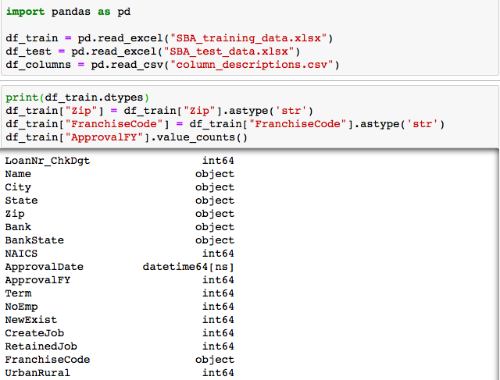
(1) A Python code that cleans the training and test data files, converting the data they contain into either two separate Numpy arrays or two separate Pandas data frames of numerical data

Slide 3
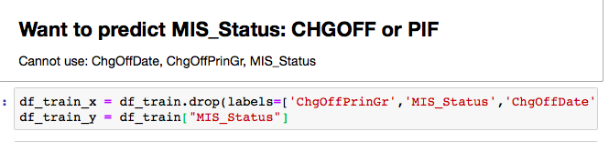
(2) A clear choice of which data variable(s) (chosen from among "ChgOffDate", "MIS_Status", and "ChgOffPrinGr") is / are to be predicted

Slide 4
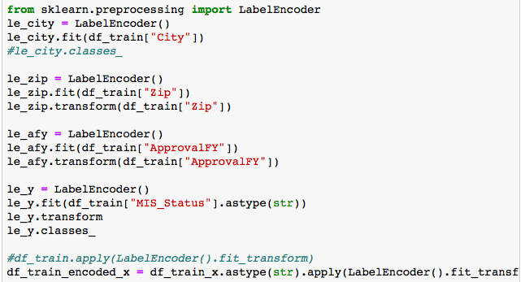
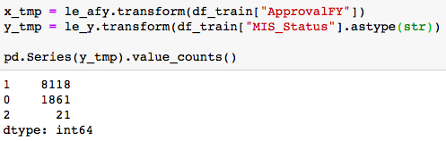

Slide 5
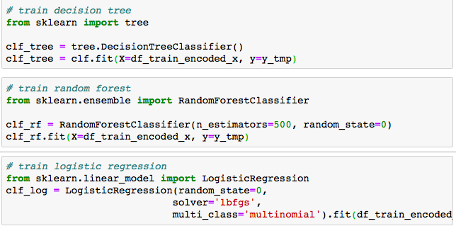
(3) At least three potential functions / models for predicting the chosen data variable

Slide 6
(4) Predicted values of the chosen data variable, as generated by these potential functions / models, over both the training and test sets

Slide 7

(5) Appropriately-chosen accuracy ratings for the potential functions / models when applied to the training set
Evaluate Decision Tree

Slide 8

Evaluate logistic regression

Slide 9

Evaluate Random Forest

